Slide 1

Inter process and inter application communication
Technology and Business Workshops at WI
Przemysław Czarnota
Software Engineer
TietoEVRY, Delivery and Operations
przemyslaw.czarnota@tietoevry.com
This presentation is licensed under a Creative Commons Attribution-ShareAlike 4.0 International License.

Slide 2
The difference between process and a computer program?

Slide 3

The difference between process and a computer program?
Program
Process

Slide 4

How can processes communicate?

Slide 5
How can processes communicate?

Slide 6
How can processes communicate?
Shared files
open(), read(), write()
Unnamed pipes
pipe(), read(), write()
Named pipes
mkfifo(), read(), write()
Message queues
mq_open()
Shared memory
shm_open(), mmap()
Unix domain sockets
socket(AF_UNIX, …), socket(AF_LOCAL, …)
Network sockets
socket(AF_INET,…) socket(AF_INET6, …)

Slide 7
How can processes communicate?
Shared files
open(), read(), write()
Unnamed pipes
pipe(), read(), write()
Named pipes
mkfifo(), read(), write()
Message queues
mq_open()
Shared memory
shm_open(), mmap()
Unix domain sockets
socket(AF_UNIX, …), socket(AF_LOCAL, …)
Network sockets
socket(AF_INET,…) socket(AF_INET6, …)

Slide 8
How can processes communicate?
Shared files
open(), read(), write()
Unnamed pipes
pipe(), read(), write()
Named pipes
mkfifo(), read(), write()
Message queues
mq_open()
Shared memory
shm_open(), mmap()
Unix domain sockets
socket(AF_UNIX, …), socket(AF_LOCAL, …)
Network sockets
socket(AF_INET,…) socket(AF_INET6, …)

Slide 9
How can processes communicate?
Shared files
open(), read(), write()
Unnamed pipes
pipe(), read(), write()
Named pipes
mkfifo(), read(), write()
Message queues
mq_open()
Shared memory
shm_open(), mmap()
Unix domain sockets
socket(AF_UNIX, …), socket(AF_LOCAL, …)
Network sockets
socket(AF_INET,…) socket(AF_INET6, …)

Slide 10
How can processes communicate?
Shared files
open(), read(), write()
Unnamed pipes
pipe(), read(), write()
Named pipes
mkfifo(), read(), write()
Message queues
mq_open()
Shared memory
shm_open(), mmap()
Unix domain sockets
socket(AF_UNIX, …), socket(AF_LOCAL, …)
Network sockets
socket(AF_INET,…) socket(AF_INET6, …)

Slide 11
How can processes communicate?
Shared files
open(), read(), write()
Unnamed pipes
pipe(), read(), write()
Named pipes
mkfifo(), read(), write()
Message queues
mq_open()
Shared memory
shm_open(), mmap()
Unix domain sockets
socket(AF_UNIX, …), socket(AF_LOCAL, …)

Slide 12
How can processes communicate?
Shared files
open(), read(), write()
Unnamed pipes
pipe(), read(), write()
Named pipes
mkfifo(), read(), write()
Message queues
mq_open()
Shared memory
shm_open(), mmap()
Unix domain sockets
socket(AF_UNIX, …), socket(AF_LOCAL, …)
Network sockets
socket(AF_INET,…) socket(AF_INET6, …)

Slide 13

Let’s talk about network sockets

Slide 14
The idea is simple

Slide 15
We have two (or possibly more) processes

Slide 16
Each one of them opens a socket
fd = socket(…)
fd = socket(…)

Slide 17
Server starts listening
fd = socket(…)
fd = socket(…)
bind(fd, addr)
listen(fd)

Slide 18
Client connects and server accepts a connection
fd = socket(…)
connect(fd)
fd = socket(…)
bind(fd, addr)
listen(fd)
cfd= accept(fd)

Slide 19
They start talking
fd = socket(…)
connect(fd)
write(fd, msg)
read(fd, resp)
fd = socket(…)
bind(fd, addr)
listen(fd)
cfd = accept(fd)
read(cfd, msg)
write(cfd, resp)

Slide 20
Eventually client disconnects
fd = socket(…)
connect(fd)
write(fd, msg)
read(fd, resp)
close(fd)
fd = socket(…)
bind(fd, addr)
listen(fd)
cfd = accept(fd)
read(cfd, msg)
write(cfd, resp)

Slide 21
And one day the server will stop listening…
fd = socket(…)
connect()
write(fd, msg)
read(fd, resp)
close(fd)
fd = socket(…)
bind(fd, addr)
listen(fd)
cfd = accept(fd)
read(cfd, msg)
write(cfd, resp)
close(fd)

Slide 22
What goes on beneath the network sockets?

Slide 23
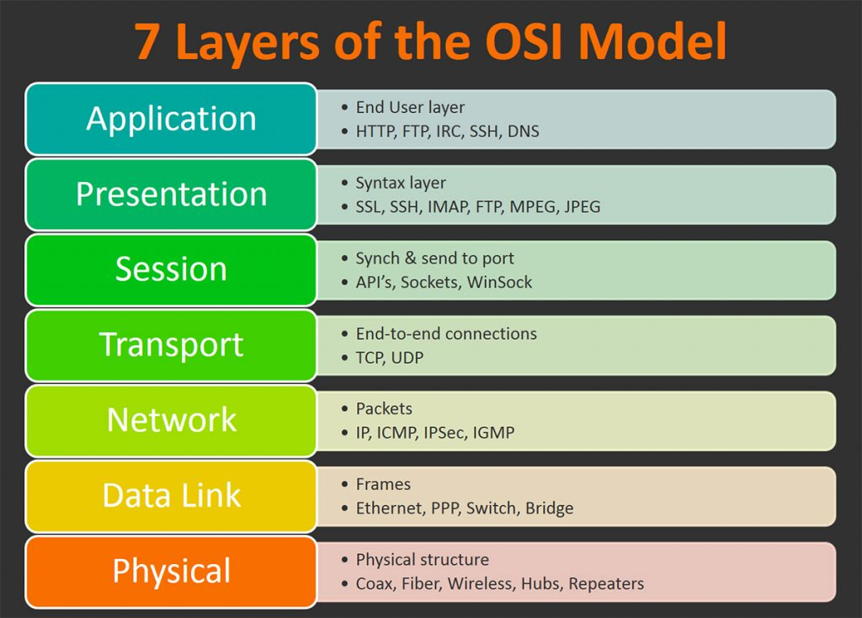
The OSI model
When you place a message in the network socket, you message „goes through” all of these stages

Slide 24
The OSI model
When you place a message in the network socket, you message „goes through” all of these stages
Network sockets are here

Slide 25
The OSI model
When you place a message in the network socket, you message „goes through” all of these stages
Network sockets are here
Your OS network stack

Slide 26
The OSI model
When you place a message in the network socket, you message „goes through” all of these stages
Network sockets are here
Your OS network stack
Your network card and its driver

Slide 27
The OSI model
When you place a message in the network socket, you message „goes through” all of these stages
Network sockets are here
Your OS network stack
Your network card and its driver
The wires or radio waves

Slide 28
The OSI model
When you place a message in the network socket, you message „goes through” all of these stages
And your application is here
Network sockets are here
Your OS network stack
Your network card and its driver
The wires or radio waves

Slide 29
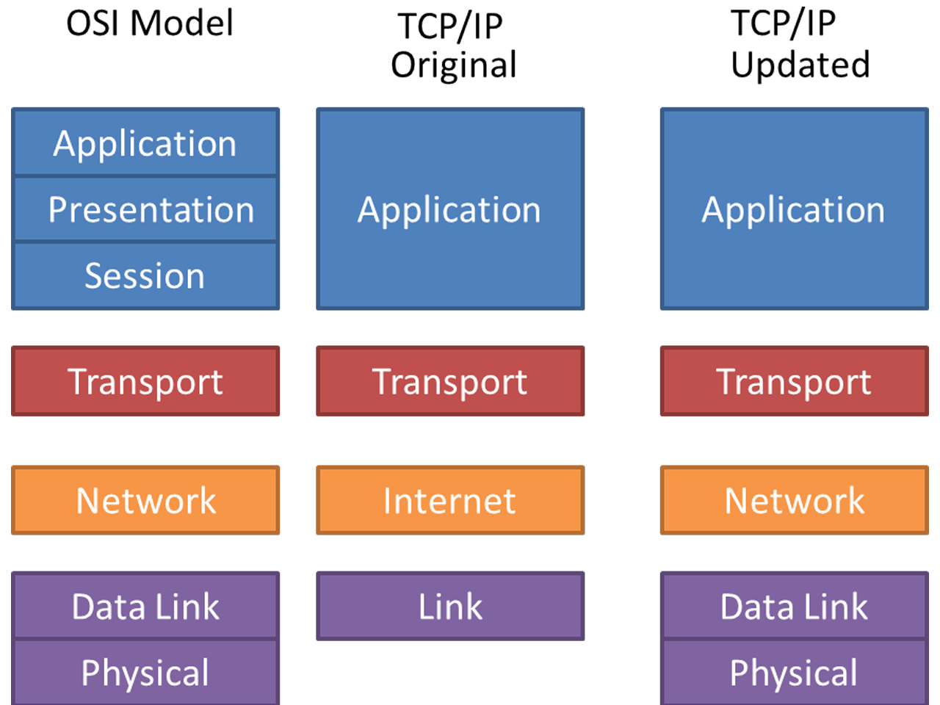
ISO OSI, TCP/IP, TCP/IP Updated
They are just conceptual models to divide responsibilities between network software and hardware components.
So that your application needs to know nothing about IP checksum calculation and modulation type used in the physical layer

Slide 30
ISO OSI, TCP/IP, TCP/IP Updated
They are just conceptual models to divide responsibilities between network software and hardware components.
So that your application needs to know nothing about IP checksum calculation and modulation type used in the physical layer
But actually some ultra high performance applications may want to be aware of elements of the network stack.
Check out Intel DPDK: https://www.dpdk.org

Slide 31
ISO OSI, TCP/IP, TCP/IP Updated
HTTP

Slide 32
HTTP
Response
HTTP/1.1 200 OK
Age: 429427
Cache-Control: max-age=604800
Content-Type: text/html; charset=UTF-8
Date: Sat, 30 Jan 2021 16:06:41 GMT
Etag: "3147526947+ident"
Expires: Sat, 06 Feb 2021 16:06:41 GMT
Last-Modified: Thu, 17 Oct 2019 07:18:26 GMT
Server: ECS (nyb/1D20)
Vary: Accept-Encoding
X-Cache: HIT
Content-Length: 1256
<!doctype html>
<html>
<head>
<title>Example Domain</title>
<meta charset="utf-8" />
<meta http-equiv="Content-type" content="text/html; charset=utf-8" />
<meta name="viewport" content="width=device-width, initial-scale=1" />
Request
GET / HTTP/1.1
Host: example.com
User-Agent: curl/7.64.1
Accept: */*

Slide 33
HTTP Request / Response
socket()

Slide 34
HTTP Request / Response
epoll_wait()
GET /spices/24 HTTP/1.1
Host: www.example.com

Slide 35
HTTP Request / Response
epoll_wait()
socket()
GET /spices/24 HTTP/1.1
Host: www.example.com

Slide 36
HTTP Request / Response
epoll_wait()
connect()
GET /spices/24 HTTP/1.1
Host: www.example.com
syn

Slide 37
HTTP Request / Response
epoll_wait()
connect()
GET /spices/24 HTTP/1.1
Host: www.example.com
iphdr
syn

Slide 38
HTTP Request / Response
epoll_wait()
connect()
GET /spices/24 HTTP/1.1
Host: www.example.com
ethhdr
iphdr
syn

Slide 39
HTTP Request / Response
epoll_wait()
connect()
GET /spices/24 HTTP/1.1
Host: www.example.com
10101010110101010

Slide 40
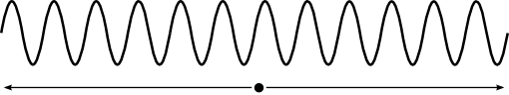
HTTP Request / Response
epoll_wait()
connect()
GET /spices/24 HTTP/1.1
Host: www.example.com

Slide 41
HTTP Request / Response
epoll_wait()
connect()
GET /spices/24 HTTP/1.1
Host: www.example.com
10101010110101010

Slide 42
HTTP Request / Response
epoll_wait()
connect()
GET /spices/24 HTTP/1.1
Host: www.example.com
ethhdr
iphdr
syn

Slide 43
HTTP Request / Response
epoll_wait()
connect()
GET /spices/24 HTTP/1.1
Host: www.example.com
iphdr
syn

Slide 44
HTTP Request / Response
epoll_wait()
connect()
GET /spices/24 HTTP/1.1
Host: www.example.com
syn

Slide 45
HTTP Request / Response
epoll_wait()
connect()
GET /spices/24 HTTP/1.1
Host: www.example.com
syn-ack

Slide 46
HTTP Request / Response
epoll_wait()
connect()
GET /spices/24 HTTP/1.1
Host: www.example.com
iphdr
syn-ack

Slide 47
HTTP Request / Response
epoll_wait()
connect()
GET /spices/24 HTTP/1.1
Host: www.example.com
ethhdr
iphdr
syn-ack

Slide 48
HTTP Request / Response
epoll_wait()
connect()
GET /spices/24 HTTP/1.1
Host: www.example.com
10101010110101010

Slide 49
HTTP Request / Response
epoll_wait()
connect()
GET /spices/24 HTTP/1.1
Host: www.example.com

Slide 50
HTTP Request / Response
epoll_wait()
connect()
GET /spices/24 HTTP/1.1
Host: www.example.com
10101010110101010

Slide 51
HTTP Request / Response
epoll_wait()
connect()
GET /spices/24 HTTP/1.1
Host: www.example.com
ethhdr
iphdr
syn-ack

Slide 52
HTTP Request / Response
epoll_wait()
connect()
GET /spices/24 HTTP/1.1
Host: www.example.com
iphdr
syn-ack

Slide 53
HTTP Request / Response
epoll_wait()
connect()
GET /spices/24 HTTP/1.1
Host: www.example.com
syn-ack

Slide 54
HTTP Request / Response
connected
epoll_wait()
GET /spices/24 HTTP/1.1
Host: www.example.com
ack

Slide 55
HTTP Request / Response
connected
epoll_wait()
GET /spices/24 HTTP/1.1
Host: www.example.com
iphdr
ack

Slide 56
HTTP Request / Response
connected
epoll_wait()
GET /spices/24 HTTP/1.1
Host: www.example.com
ethhdr
iphdr
ack

Slide 57
HTTP Request / Response
connected
epoll_wait()
GET /spices/24 HTTP/1.1
Host: www.example.com
10101010110101010

Slide 58
HTTP Request / Response
connected
epoll_wait()
GET /spices/24 HTTP/1.1
Host: www.example.com

Slide 59
HTTP Request / Response
connected
epoll_wait()
GET /spices/24 HTTP/1.1
Host: www.example.com
10101010110101010

Slide 60
HTTP Request / Response
connected
epoll_wait()
GET /spices/24 HTTP/1.1
Host: www.example.com
ethhdr
iphdr
ack

Slide 61
HTTP Request / Response
connected
epoll_wait()
GET /spices/24 HTTP/1.1
Host: www.example.com
iphdr
ack

Slide 62
HTTP Request / Response
connected
accept()
GET /spices/24 HTTP/1.1
Host: www.example.com
ack

Slide 63
HTTP Request / Response
connected
accepted
GET /spices/24 HTTP/1.1
Host: www.example.com

Slide 64
HTTP Request / Response
connected
accepted
write()
epoll_wait()
GET /spices/24 HTTP/1.1
Host: www.example.com

Slide 65
HTTP Request / Response
connected
accepted
epoll_wait()
read()
tcp h
GET /spices/24 HTTP/1.1
Host: www.example.com

Slide 66
HTTP Request / Response
connected
accepted
epoll_wait()
read()
iph
tcp h
GET /spices/24 HTTP/1.1
Host: www.example.com

Slide 67
HTTP Request / Response
connected
accepted
epoll_wait()
read()
eth
iph
tcp h
GET /spices/24 HTTP/1.1
Host: www.example.com

Slide 68
HTTP Request / Response
connected
accepted
epoll_wait()
read()
10101010110101010

Slide 69
HTTP Request / Response
connected
accepted
epoll_wait()
read()

Slide 70
HTTP Request / Response
connected
accepted
epoll_wait()
read()
10101010110101010

Slide 71
HTTP Request / Response
connected
accepted
epoll_wait()
read()
eth
iph
tcp h
GET /spices/24 HTTP/1.1
Host: www.example.com

Slide 72
HTTP Request / Response
connected
accepted
epoll_wait()
iph
tcp h
GET /spices/24 HTTP/1.1
Host: www.example.com

Slide 73
HTTP Request / Response
connected
accepted
epoll_wait()
read()
tcp h
GET /spices/24 HTTP/1.1
Host: www.example.com

Slide 74
HTTP Request / Response
connected
accepted
read()
read()
GET /spices/24 HTTP/1.1
Host: www.example.com

Slide 75
HTTP Request / Response
connected
accepted
write()
read()
HTTP/1.1 200 OK
Content-Type: text/html

Slide 76
HTTP Request / Response
connected
accepted
epoll_wait()
read()
tcp h
HTTP/1.1 200 OK
Content-Type: text/html

Slide 77
HTTP Request / Response
connected
accepted
epoll_wait()
read()
iph
tcp h
HTTP/1.1 200 OK
Content-Type: text/html

Slide 78
HTTP Request / Response
connected
accepted
epoll_wait()
read()
eth
iph
tcp h
HTTP/1.1 200 OK
Content-Type: text/html

Slide 79
HTTP Request / Response
connected
accepted
epoll_wait()
read()
10101010110101010

Slide 80
HTTP Request / Response
connected
accepted
epoll_wait()
read()

Slide 81
HTTP Request / Response
connected
accepted
epoll_wait()
read()
10101010110101010

Slide 82
HTTP Request / Response
connected
accepted
epoll_wait()
read()
eth
iph
tcp h
HTTP/1.1 200 OK
Content-Type: text/html

Slide 83
HTTP Request / Response
connected
accepted
epoll_wait()
read()
iph
tcp h
HTTP/1.1 200 OK
Content-Type: text/html

Slide 84
HTTP Request / Response
connected
accepted
epoll_wait()
read()
tcp h
HTTP/1.1 200 OK
Content-Type: text/html

Slide 85
HTTP Request / Response
connected
accepted
close()
epoll_wait()
HTTP/1.1 200 OK
Content-Type: text/html

Slide 86
HTTP Request / Response
disconnected
epoll_wait()

Slide 87

High level methods of communication between application components

Slide 88

CORBA
GIOP, IIOP

Slide 89
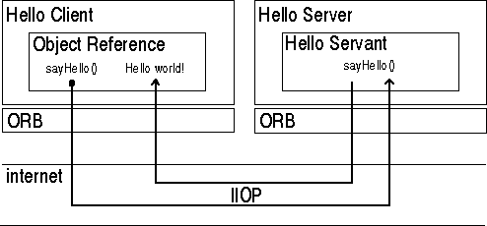
CORBA

Slide 90
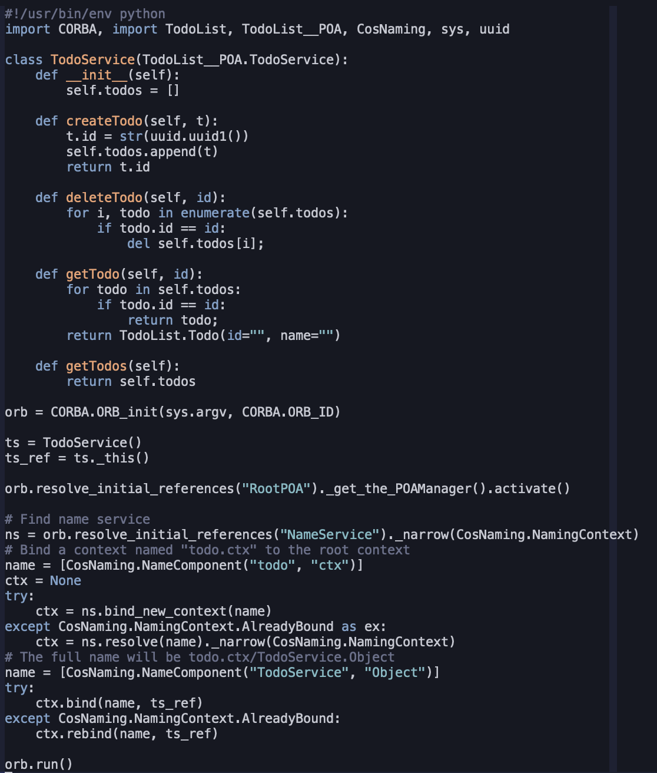
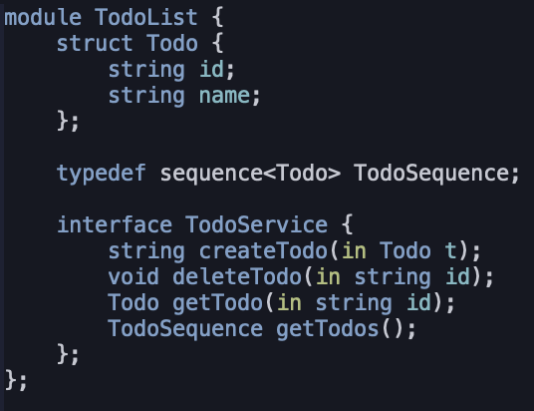
CORBA – Todo list server
IDL

Slide 91
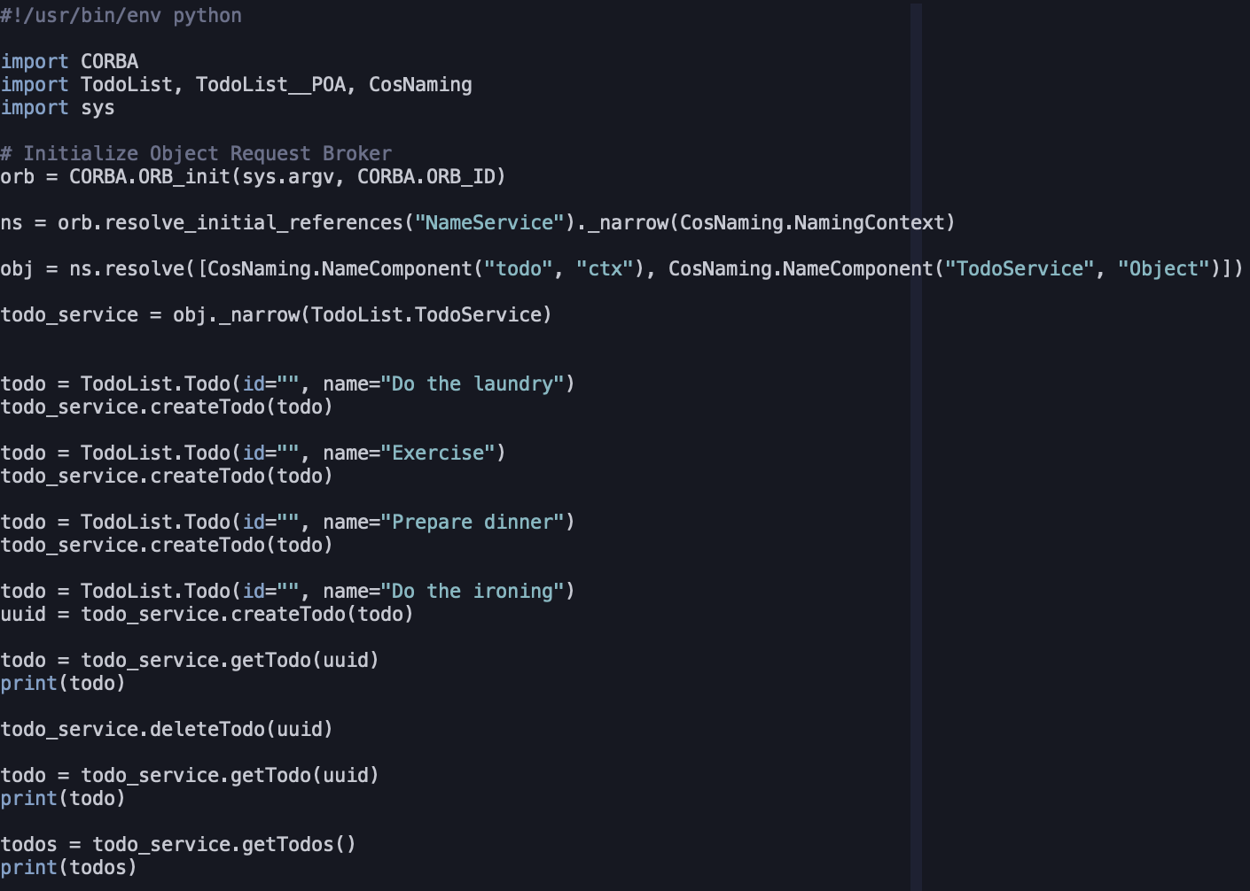
CORBA – TodoList client
IDL

Slide 92
SOAP
Simple Object Access Protocol
Request
Response
POST /InStock HTTP/1.1
Host: www.example.org
Content-Type: application/soap+xml; charset=utf-8
Content-Length: nnn
<?xml version="1.0"?>
<soap:Envelope
xmlns:soap="http://www.w3.org/2001/12/soap-envelope"
soap:encodingStyle="http://www.w3.org/2001/12/soap-encoding">
<soap:Body xmlns:m="http://www.example.org/stock">
<m:GetStockPrice>
<m:StockName>IBM</m:StockName>
</m:GetStockPrice>
</soap:Body>
</soap:Envelope>
HTTP/1.1 200 OK
Content-Type: application/soap+xml; charset=utf-8
Content-Length: nnn
<?xml version="1.0"?>
<soap:Envelope
xmlns:soap="http://www.w3.org/2001/12/soap-envelope"
soap:encodingStyle="http://www.w3.org/2001/12/soap-encoding">
<soap:Body xmlns:m="http://www.example.org/stock">
<m:GetStockPriceResponse>
<m:Price>34.5</m:Price>
</m:GetStockPriceResponse>
</soap:Body>
</soap:Envelope>

Slide 93
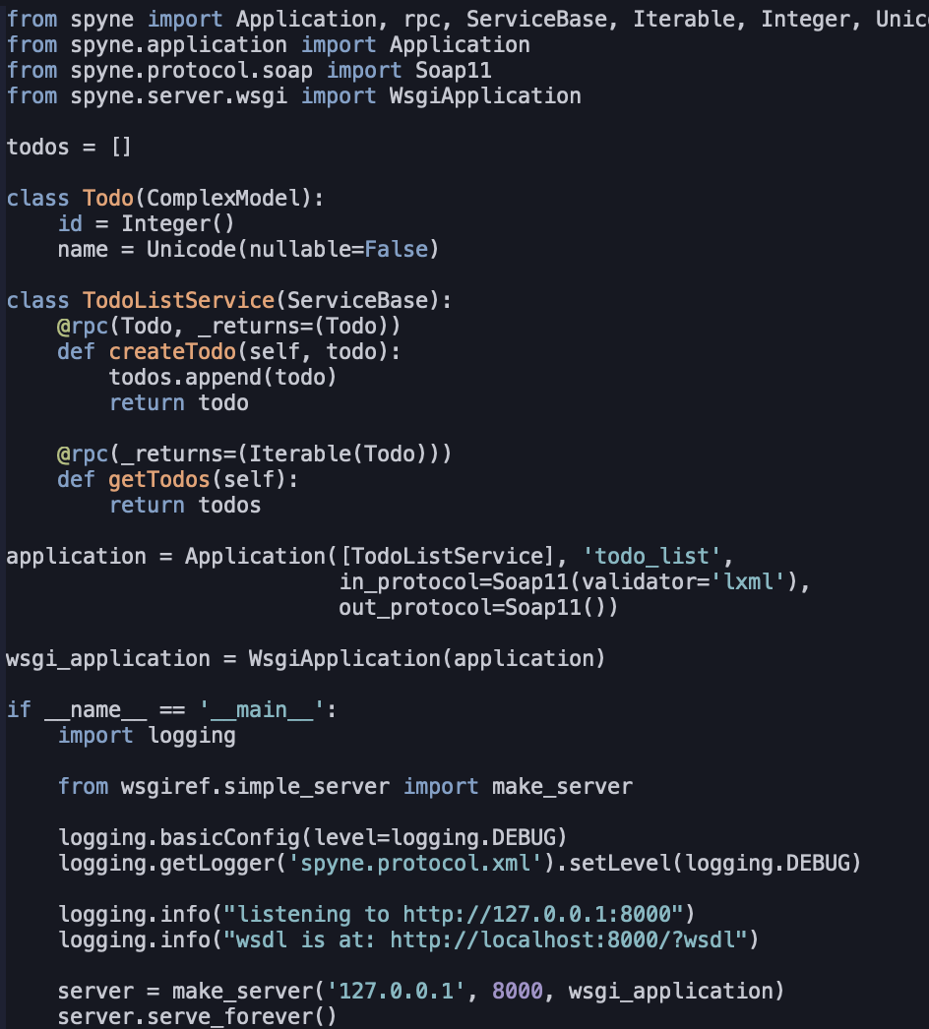
SOAP
Web Service Definition Language (wsdl)
Example server in python
http://localhost/?wsdl
<wsdl:definitions ...>
<wsdl:types>...</wsdl:types>
<wsdl:message name="createTodo">...</wsdl:message>
<wsdl:message name="createTodoResponse">...</wsdl:message>
<wsdl:message name="getTodos">...</wsdl:message>
<wsdl:message name="getTodosResponse">...</wsdl:message>
<wsdl:service name="TodoListService">...</wsdl:service>
<wsdl:portType name="Application">...</wsdl:portType>
<wsdl:binding name="Application" type="tns:Application">...</wsdl:binding>
</wsdl:definitions>

Slide 94
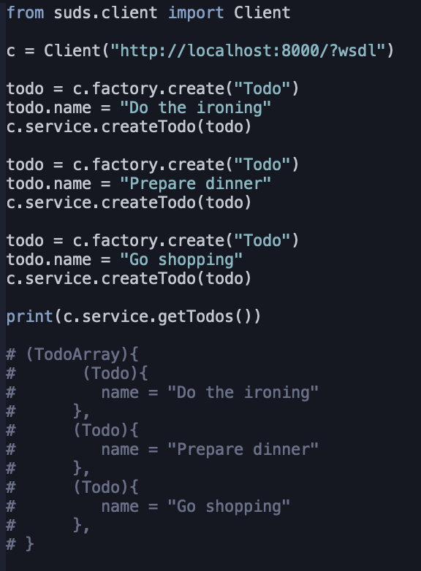
SOAP Client
Client in python
Response

Slide 95
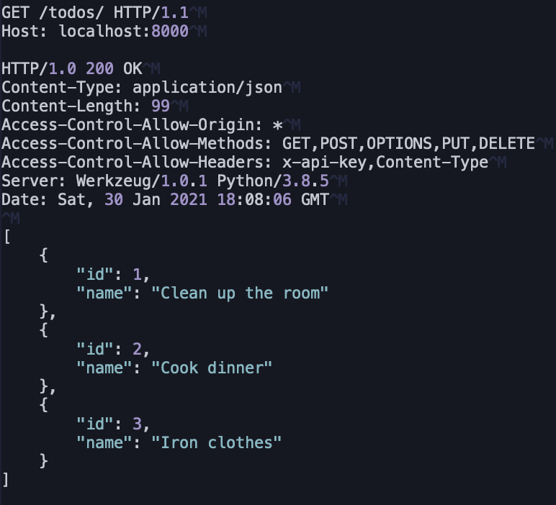
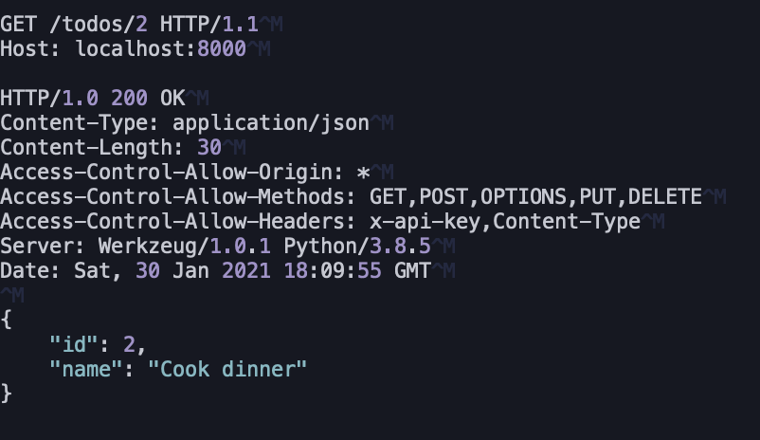
REST
Representational State Transfer

Slide 96
REST is not a protocol, but an architectural pattern

Slide 97
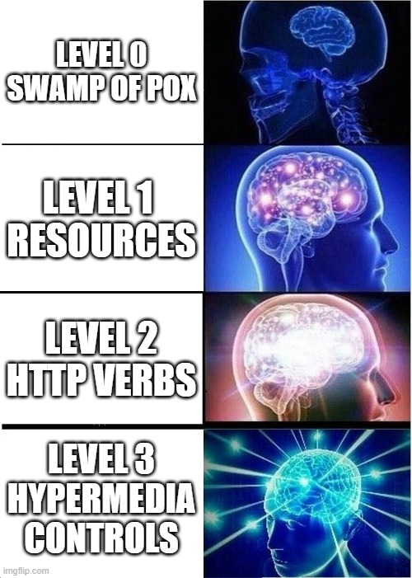
REST Maturity Model
developed by Leonard Richardson

Slide 98
Level 0 Swamp of POX
POST /apiEndpointThatHandlesEverything HTTP/1.1
[headers]
{ ”api_call”: ”create_todo”, ”name”: ”Do the laundry” }
HTTP/1.1 200 OK
[headers]
{ ”response”: ”created” }
POST /apiEndpointThatHandlesEverything HTTP/1.1
[headers]
{ ”api_call”: ”get_todo”, ”id”: 1 }
HTTP/1.1 200 OK
[headers]
{ ”todo”: { ”name”: ”Do the laundry”}}
POST /apiEndpointThatHandlesEverything HTTP/1.1
[headers]
{ ”api_call”: ”delete_todo”, ”id”: 1 }
HTTP/1.1 200 OK
[headers]
{ ”response”: ”deleted” }

Slide 99
Level 1 Resources
POST /todos/create HTTP/1.1
[headers]
{”name”: ”Do the laundry” }
HTTP/1.1 200 OK
[headers]
{”id”: 1, ”name”: ”Do the laundry”}
POST /todos/1 HTTP/1.1
[headers]
HTTP/1.1 200 OK
[headers]
{”id”: 1, ”name”: ”Do the laundry”}
HTTP/1.1 200 OK
[headers]
POST /todos/1/delete HTTP/1.1
[headers]

Slide 100
Level 2 HTTP Verbs
POST /todos/ HTTP/1.1
[headers]
{”name”: ”Do the laundry” }
HTTP/1.1 201 Created
[headers]
{”id”: 1, ”name”: ”Do the laundry”}
GET /todos/1 HTTP/1.1
[headers]
HTTP/1.1 200 OK
[headers]
{”id”: 1, ”name”: ”Do the laundry”}
HTTP/1.1 204 No content
[headers]
DELETE /todos/1 HTTP/1.1
[headers]

Slide 101
Level 2 HTTP Verbs
HTTP Verbs
GET
HEAD
POST
PUT
DELETE
CONNECT
OPTIONS
TRACE
PATCH
HTTP Response codes
Informational responses (100–199)
Successful responses (200–299)
Redirects (300–399)
Client errors (400–499)
Server errors (500–599)
Most used for REST
200 OK
201 Created
202 Accepted
204 No Content
301 Moved Permanently
400 Bad Request
401 Unauthorized
403 Forbidden
404 Not Found
405 Method not

Slide 102
Level 3 Hypermedia Controls
HTTP/1.1 201 Created
[headers]
{
”id”: 1, ”name”: ”Do the laundry”
”links”: [
{”rel”: ”delete”, ”href”: ”https://api.com/todos/1/” },
{”rel”: ”edit”, ”href”: ”https://api.com/todos/1/”}
{”rel”: ”tags”, ”href”, ”https://api.com/tags” }
]
}
POST /todos/ HTTP/1.1
[headers]
{”name”: ”Do the laundry” }
HTTP/1.1 200 OK
[headers]
{
”id”: 1, ”name”: ”Do the laundry”
”links”: [
{”rel”: ”delete”, ”href”: ”https://api.com/todos/1/” },
{”rel”: ”edit”, ”href”: ”https://api.com/todos/1/”}
{”rel”: ”tags”, ”href”, ”https://api.com/tags/” }
]
}
GET /todos/1 HTTP/1.1
[headers]
DELETE /todos/1 HTTP/1.1
[headers]
HTTP/1.1 204 No content
[headers]

Slide 103

Cross Origin Resource Sharing
„For security reasons, browsers restrict cross-origin HTTP requests initiated from scripts. For example, XMLHttpRequest and the Fetch API follow the same-origin policy. This means that a web application using those APIs can only request resources from the same origin the application was loaded from unless the response from other origins includes the right CORS headers.” ~ https://developer.mozilla.org/en-US/docs/Web/HTTP/CORS
Which means that
Javascript served from http://foo.com
Origin: http://foo.com
Server listening at
http://bar.com
NO!
Response from http://bar.com
Outraged browser protecting your best interests

Slide 104

Cross Origin Resource Sharing
„For security reasons, browsers restrict cross-origin HTTP requests initiated from scripts. For example, XMLHttpRequest and the Fetch API follow the same-origin policy. This means that a web application using those APIs can only request resources from the same origin the application was loaded from unless the response from other origins includes the right CORS headers.” ~ https://developer.mozilla.org/en-US/docs/Web/HTTP/CORS
Which means that
Javascript served from http://foo.com
Origin: http://foo.com
Server listening at
http://bar.com
OK
Access-Control-Allow-Origin: *
Happy browser protecting your best interests

Slide 105
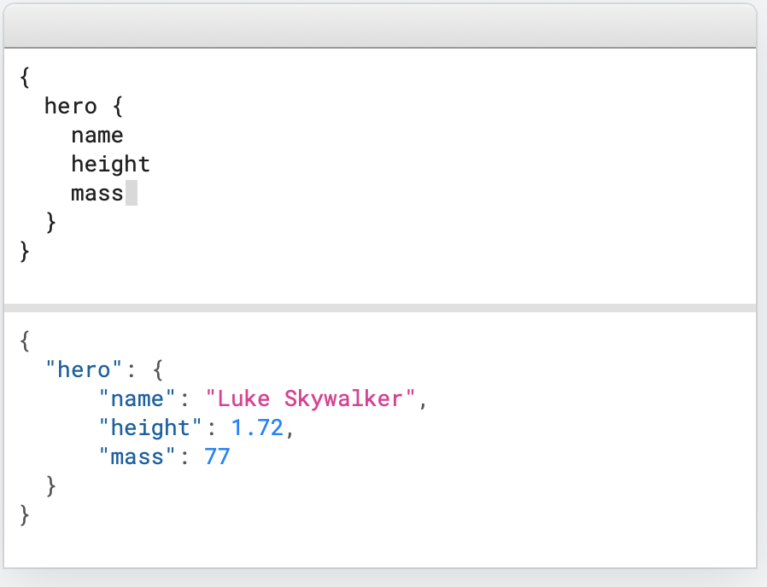
GraphQL

Slide 106
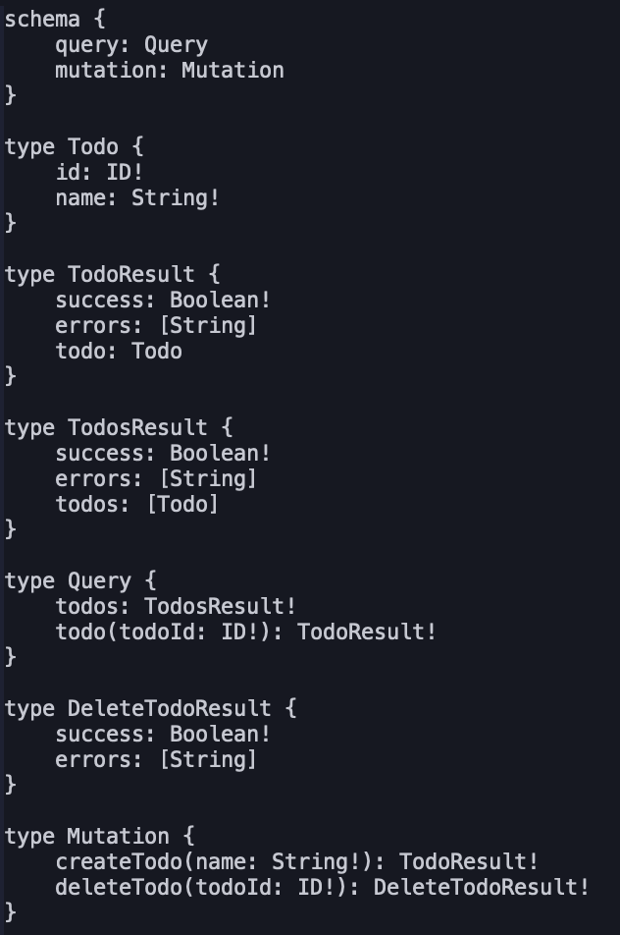
GraphQL
Schema

Slide 107
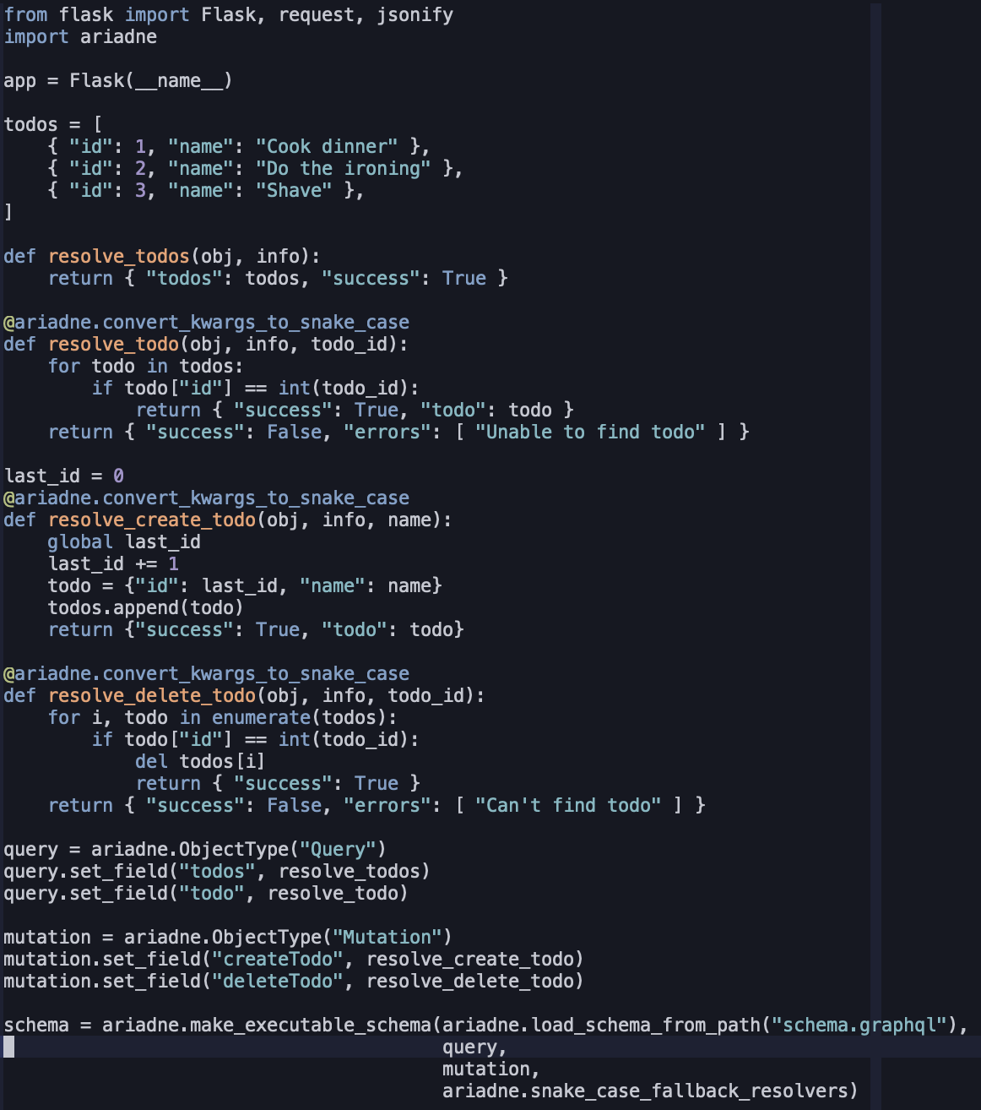
GraphQL
Example server using Ariadne

Slide 108
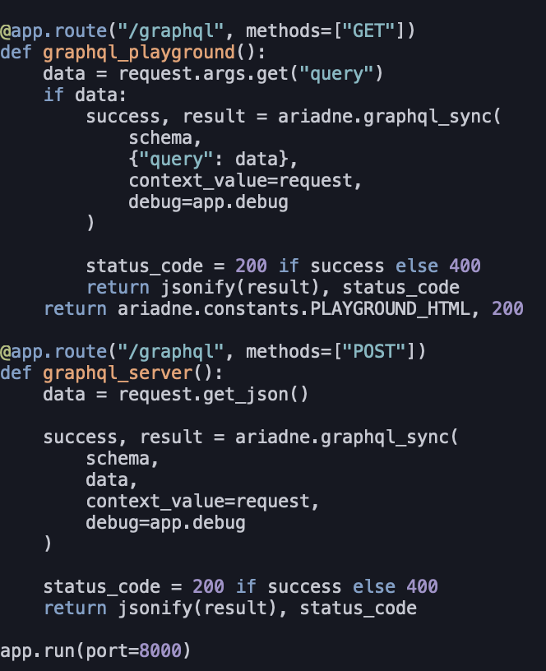
GraphQL
Serving Ariadne graphql implementation with Flask

Slide 109

RESTful Task List
Task
Extend API of the Todo List application written in Flask framework.
Currently it implements REST api at level 1
Implement API levels 2 (http verbs and response codes) and 3 (HATEOAS) to make it RESTful
You can find the source code at:
https://github.com/czarnota/al/
In the directory: todo-rest
Check the todo-rest/README.md for more details
Your implementation should pass test_todo.py test case
Create a PR with solution or send a zip archive to p@czarnota.io

Slide 110
Further reading
https://martinfowler.com/articles/richardsonMaturityModel.html
https://graphql.org
https://www.twilio.com/blog/graphql-api-python-flask-ariadne
https://marekwywial.name/posts/blog20130813python-soap-server-flask-wsdl-generation.html
http://omniorb.sourceforge.net/omnipy42/omniORBpy/
https://tldp.org/LDP/lpg/node7.html
https://beej.us/guide/bgnet/
https://flask.palletsprojects.com/en/1.1.x/

Slide 111
Przemysław Czarnota
Software Engineer
TietoEVRY, Delivery & Operations
przemyslaw.czarnota@tietoevry.com
p@czarnota.io

